Slide 1
FSM Online Internship
Piston Defect Detection Using Computer Vision
Ananya Mohapatra
National Institute of Science and Technology,Berhampur
Under Mentorship of
Keivalya Pandya
IITD-AIA FOUNDATION FOR SMART MANUFACTURING

Slide 2
Project Background
adaptability to dynamic manufacturing conditions.
The project addresses the critical need for an automated defect detection solution in piston manufacturing. Traditional manual inspection methods are time-consuming, subjective, and prone to errors.
By Using Machine Learning and Computer Vision, piston defect detection achieves exceptional accuracy in identifying and categorizing defects within pistons.
Unique challenges
Real-time processing
Adaptability to dynamic manufacturing conditions
Defect Variation

Slide 3
Objective
Created a robust automated system for detecting and categorizing defects in pistons using Machine Learning and Computer Vision.
Performing Explanatory Data Analysis on the piston dataset.
Collected a dataset of AC piston images with a diverse range of defect types. Preprocessed the images to ensure consistency and Complete data augmentation techniques.
Developed a Convolutional Neural Network (CNN) architecture for piston defect detection. Trained the model using the piston dataset to learn the features and patterns of different defects.
Fine-tuned the CNN model using transfer learning to enhance its performance. Experiment with various hyperparameters and architectures to optimize accuracy.

Slide 4
Methodology
Explanatory Data Analysis
Conducted a thorough exploratory analysis of the collected piston image dataset. Examined the distribution of defect types, analyzed image quality, and identified any data inconsistencies.
Detection and Visualization
Visualized the output of the model using different piston images.(normal and defected)
Model Training
Splited the dataset into training, validation, and test sets.
Trained the selected model using the training piston dataset, optimized parameters and loss functions to achieve accurate defect classification.
Model Selection
Selected suitable Machine Learning model, such as Convolutional Neural Networks (CNNs), known for their image processing capabilities.
Deployment
Deployed the model locally using FastAPI.

Slide 5
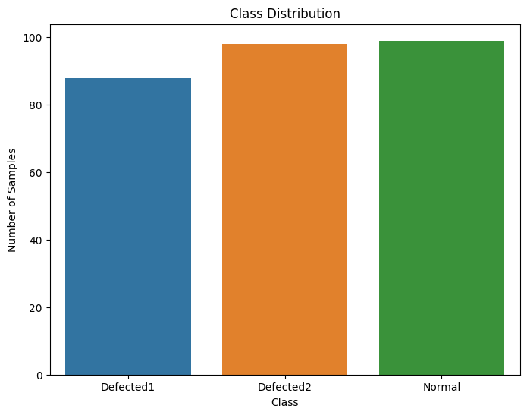
Implementation
Explanatory Data Analysis
Piston_Dataset/
├── Defected1/
│ ├── kumda_component1.png
│ ├── kumda_component2.png
│ └── ...
├── Defected2/
│ ├── kumda_component1.png
│ ├── kumda_component2.png
│ └── ...
└── Normal/
├── kumda_component1.png
├── kumda_component2.png
└── ...

Slide 6
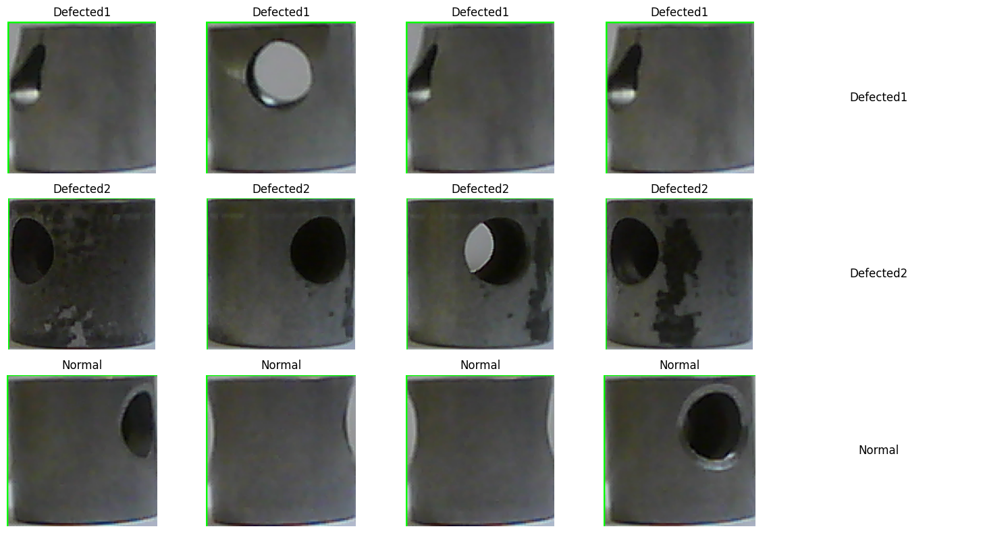
Implementation

Slide 7
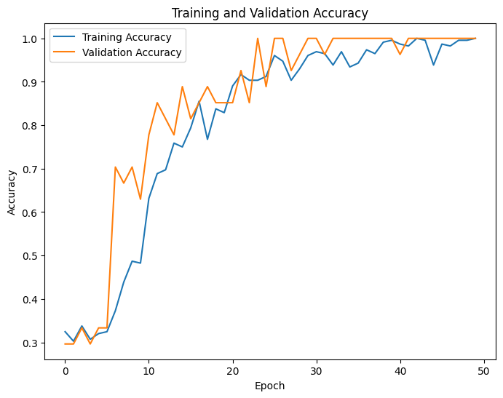
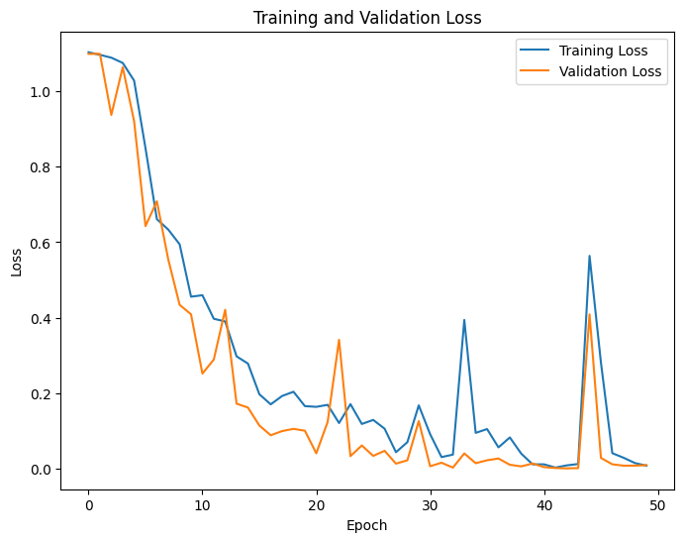
Implementation

Slide 8
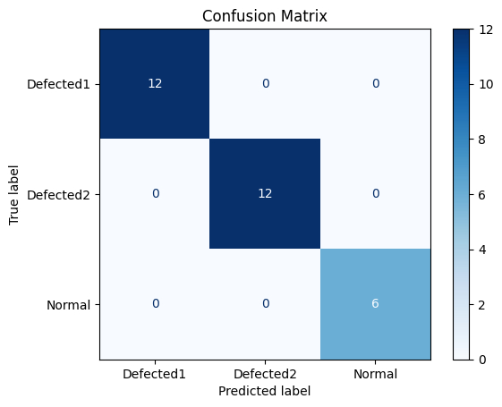
Implementation

Slide 9
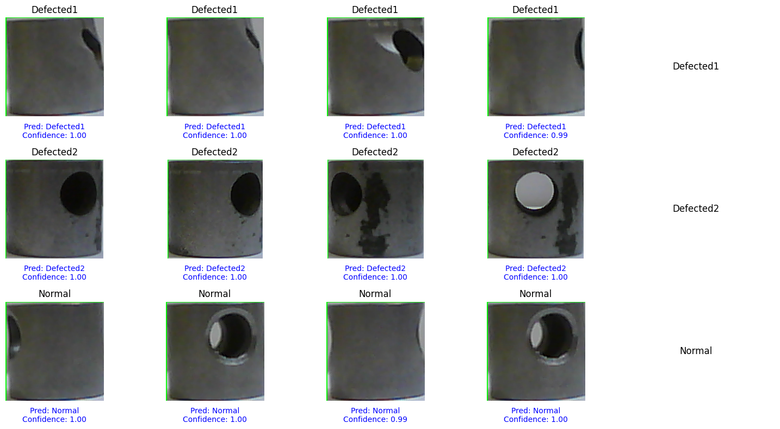
Implementation

Slide 10
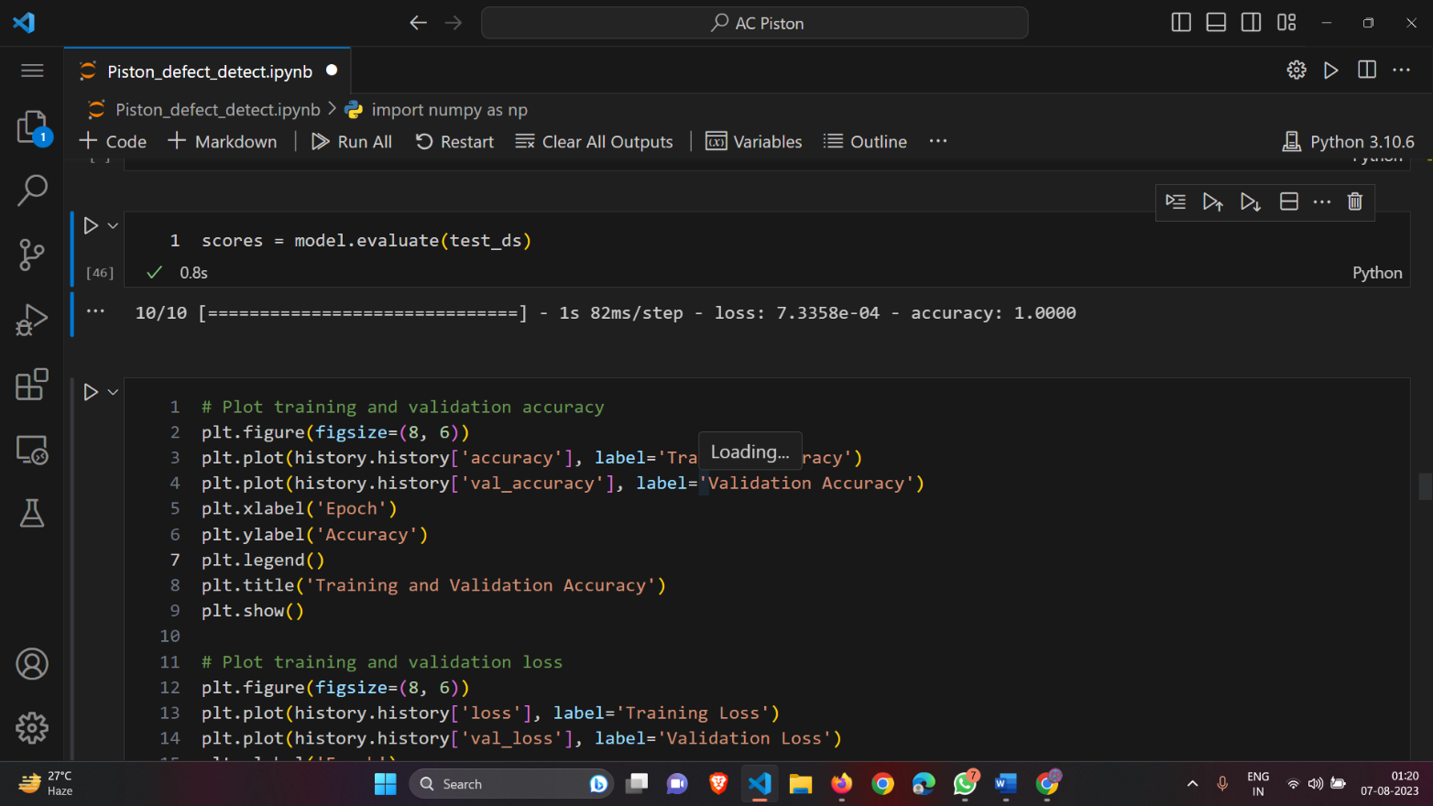
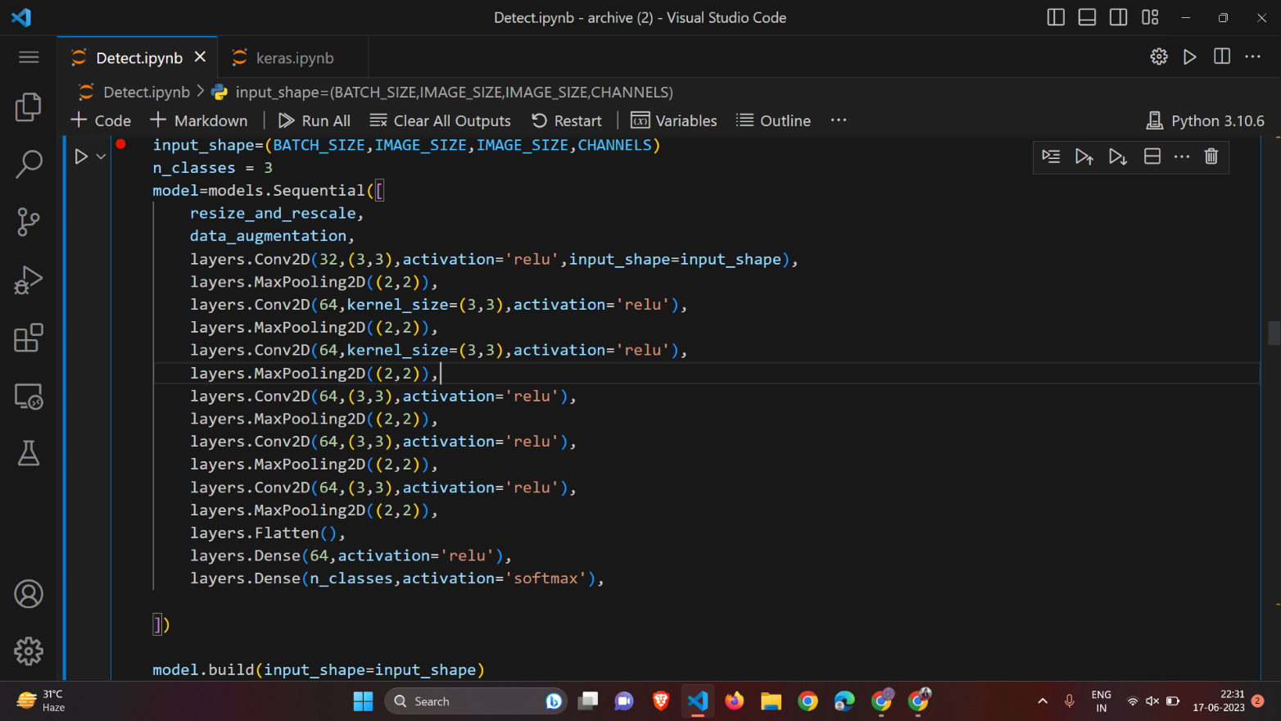
Implementation

Slide 11
Innovation in Implementation
Achieving 100% Accuracy: A Remarkable Milestone in Piston Defect Detection
The attainment of 100% accuracy in our piston defect detection system represents a significant breakthrough in the realm of manufacturing quality control

Slide 12
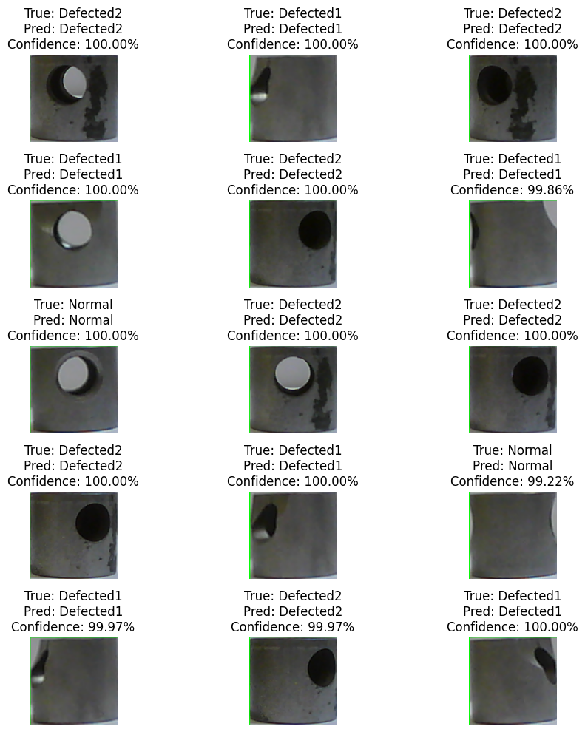
Outcome

Slide 13
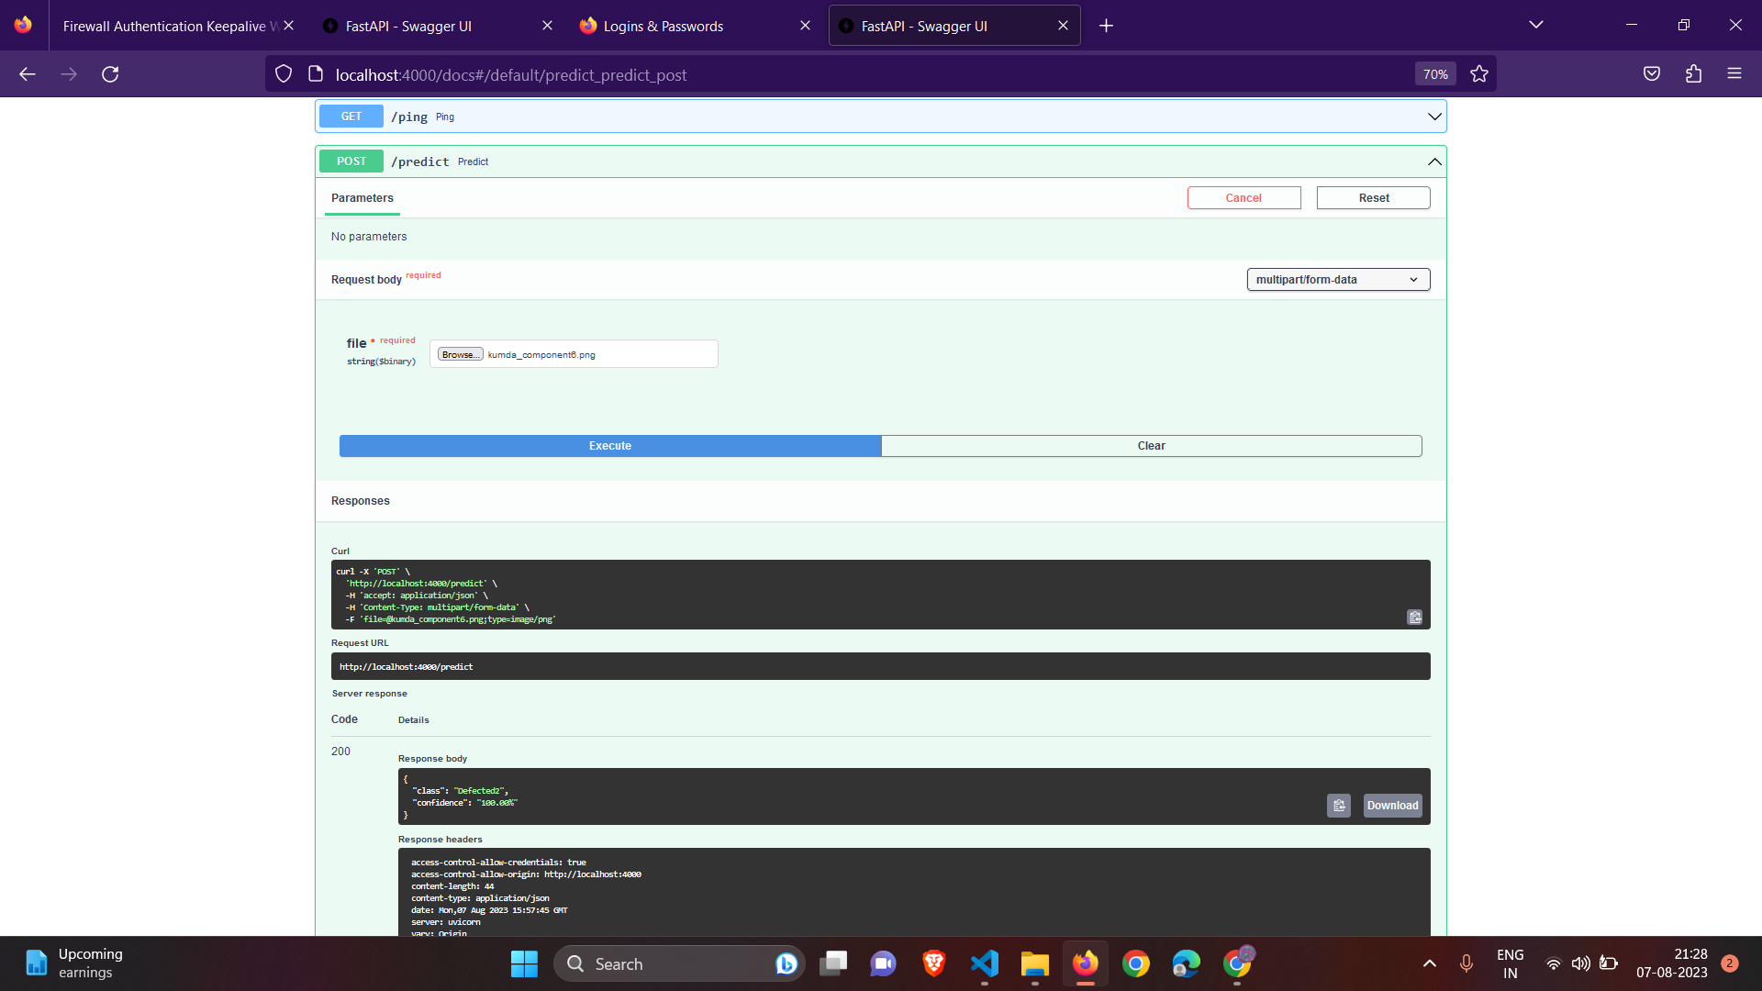
Outcome

Slide 14
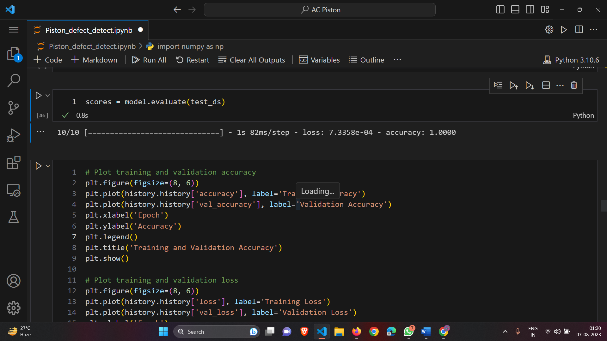
Outcome

Slide 15
Scalability
In piston defect detection, scalability plays a pivotal role in not only solving immediate industrial problems but also preparing for future challenges.
The scalability inherent in our solution allows for seamless integration into diverse industrial settings, enabling efficient and precise defect detection across various manufacturing processes.
In the future, I will use cloud resources to accommodate larger datasets and real-time processing, ensuring effective defect detection across expanding industrial operations.

Slide 16
Thank You
amb120@nist.edu

